Slide 1
Most popular books over the World
Data mining and machine-learning
Final course project By:
Lior Silman
Daniel Shkilar

Slide 2






falling action
epilogue
rising action
Crawling
EDA
Summary
Defying type of object we will crawl. Presenting the difficulties we had. Code explanations.
Pictures of Graphs
Presenting our conclusions and summarize the Presentation
7-12
15-21
28-32
3-6
Background
13 -14
Cleaning Data
22-27
Machine Learning
Presenting motivation and the problem we dealing with. External Resources
Code Example from our Jupiter Notebook
Examples of our methods More pictures. Wow effect
exposition
climax
denouement

Slide 3
Background

Slide 4
Background
From the moment books were invented hundreds or thousands years ago, the rising of interesting is permanent.
Today, The huge variety of books and genres is in unimaginable dimensions. Thus, we believe is available to allocate information about the most popular books and create very valuable data.
The main goal is to generate predictions on beloved books by genre, recommendations and other criteria.

Slide 5

Our Research subject
What is the perfect book of this era and decades before?
Is there any popular most genre?
How ratings and reviews contribute to the grade of books of ?
How the books attributes help us to make specific predictions ?

Slide 6



External Resources
Best Books Ever (70465 books) | Goodreads

Slide 7
Crawling

Slide 8

crawling
We extract for each book webpage all the elements we evaluate as necessary for future analyses such as:
Name of book
How many ratings
Average rating (ranked between 1- 5)
Top 3 genres that describing the books in accordance to users
Publisher Name
Author Name
Reviews
Number of pages
Original Book language
Year of release
* All the scrapping used by BeautifulSoup Library

Slide 9

crawling
Main Problem
Optimization
01
03
At start, after a few tries we found permanent unexpected crush while running the code
We ran the code few times and got different dataframes. So we combined them to minimize the missing rows
What we do
Finally
02
04
We changed our code accordantly by adding try/except and URL arrays to dataframe.
We build a code that found our missing books (rows) and generated their missing urls

Slide 10
crawling
range | Type of value | Name of the column
7000 Books | String | Name of Book
0 - 8098147 | Int | How many ratings
0-5 | Float | Average rating
1746 different publishers | String | Publisher Name
3172 different Authros | String | Author Name
0 - 180891 | int | Reviews
8 - 8258 | Int | Number of pages
Arabic , English, Spanish, Turkish, Tamil, Urdu | String | Original Book language
136 – 2021 (until 1951 we have only 9 books) | Int | Year of release
244 Genres Exist in the Dataframe | String | Genre 1
244 Genres Exist in the Dataframe | String | Genre 2
244 Genres Exist in the Dataframe | string | Genre 3

Slide 11

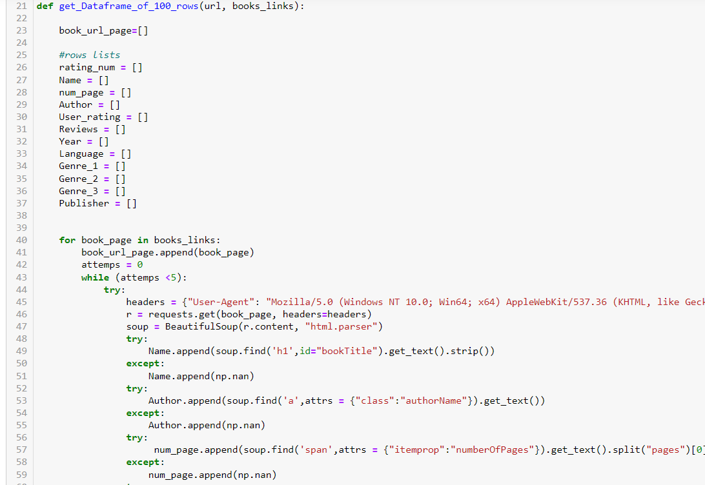
How we scraped the data we looked for
The website consist 100 books per page, therefore we add new 100 rows per time unit
The website consist 100 books per page, therefore we add new 100 rows per time unit

Slide 12
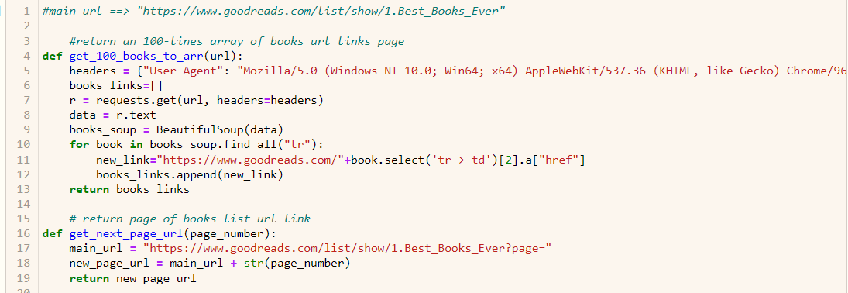
More Coding
Useful functions to advance sub-links and provide specific book page for each book

Slide 13
Data Cleaning

Slide 14

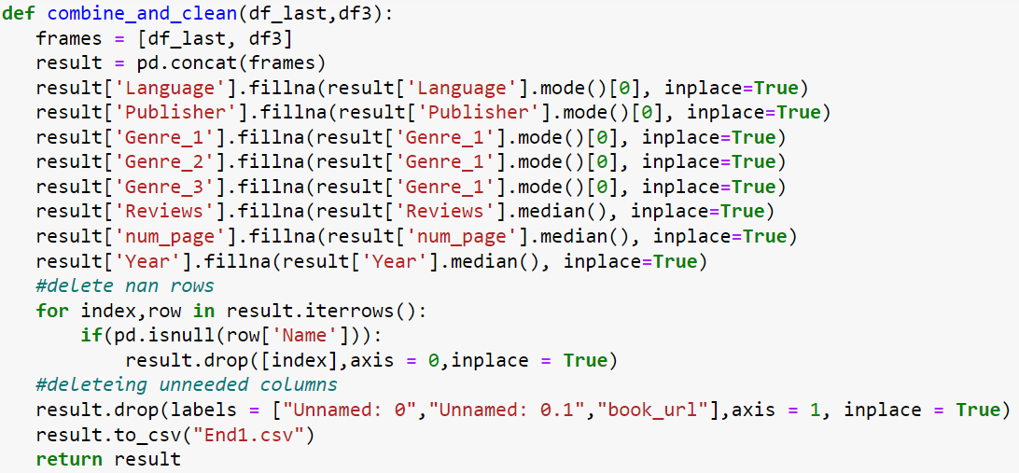
Data Cleaning
Clean data
As expected we faced some issues with the dataset such as wrong type of columns objects, irrelevant dots or commas in strings and of course missing data. As so, we created the solution right here

Slide 15
EDA & Visualization

Slide 16

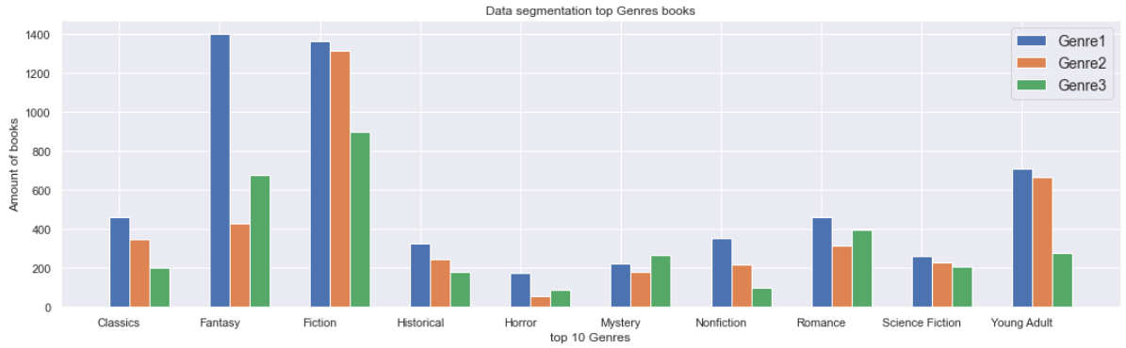
Bars plot

Slide 17
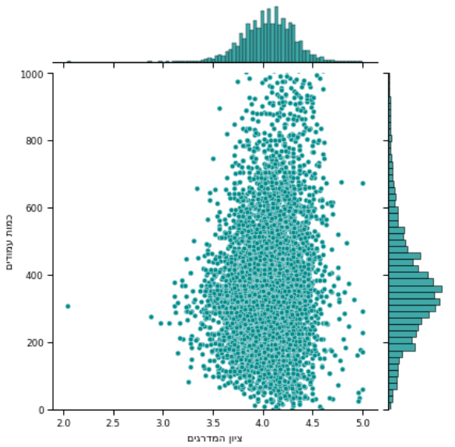
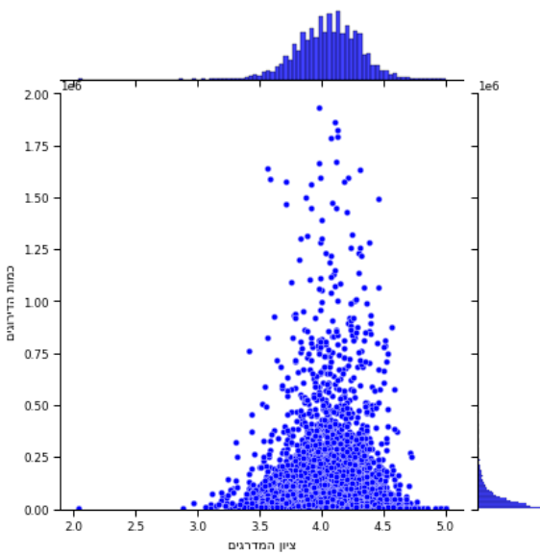
Scatter plot

Slide 18
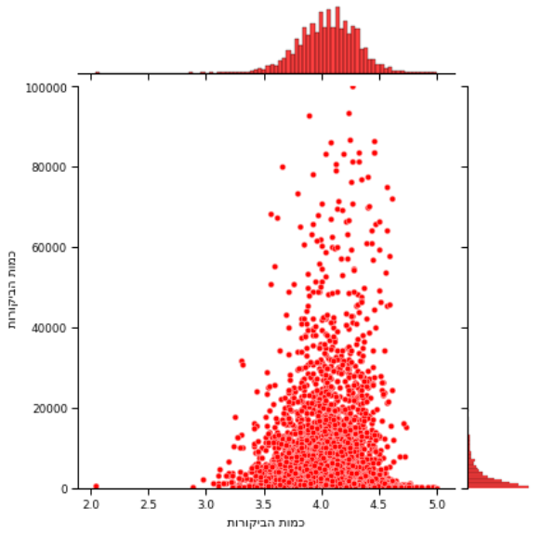
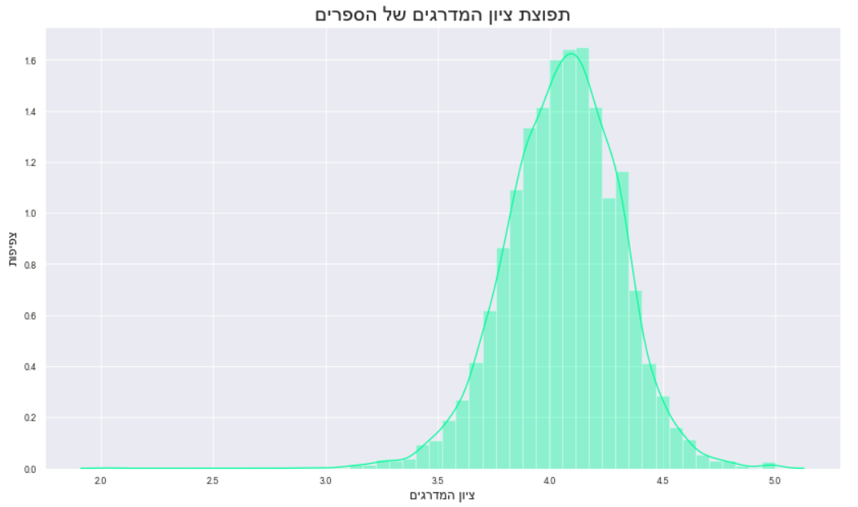

Scatter & hist plot
Gaussian distribution

Slide 19
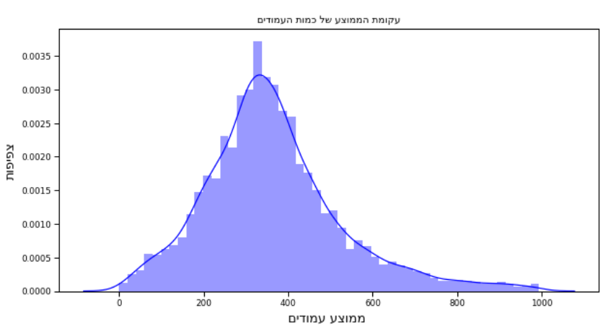
histograma plot
Gaussian distribution

Slide 20




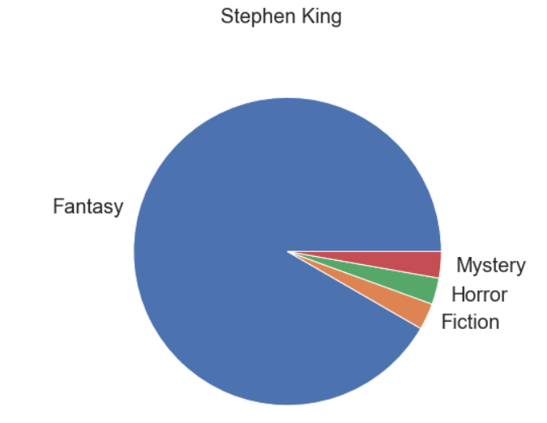
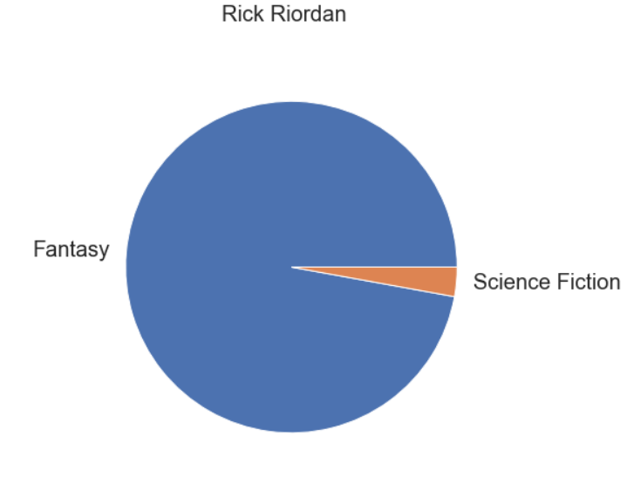
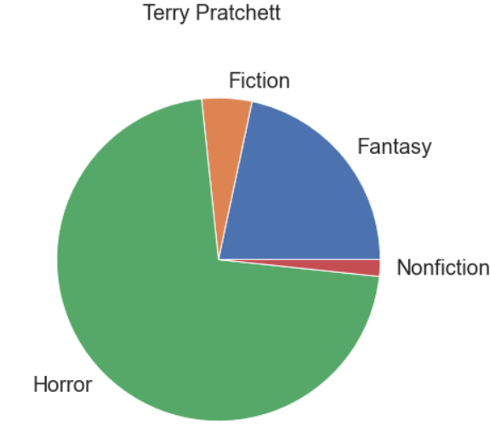
Pie Plot
2nd Place
3rd Place
1st Place
60 books
39 books
32 books

Slide 21

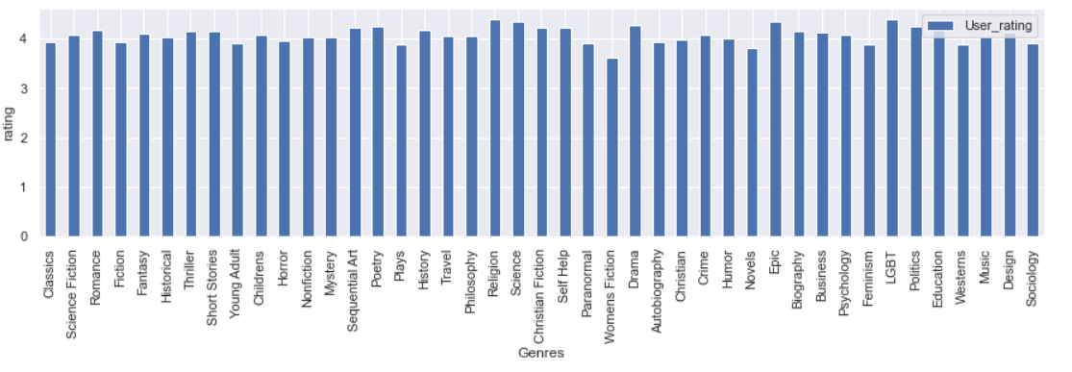
Histogram

Slide 22
Machine Learning

Slide 23
Machine Learning
After EDA part, we tried to create an algorithm to predict rating of book by his parameters. At first, we used Linear Regression method
By adding the genres as columns (get_dummies) we reduced the error

Slide 24
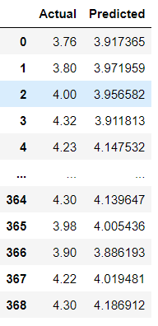

Machine Learning
Here, we can see the accuracy presentages in the bottom-left corner
print('MAE:', metrics.mean_absolute_error(y_test, predictions))
print('MSE:', metrics.mean_squared_error(y_test, predictions))
print('RMSE:', np.sqrt(metrics.mean_squared_error(y_test, predictions)))
MAE: 0.15151835939921227
MSE: 0.035649196206375564
RMSE: 0.18880994731839623

Slide 25
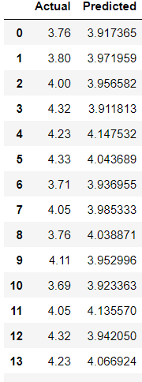

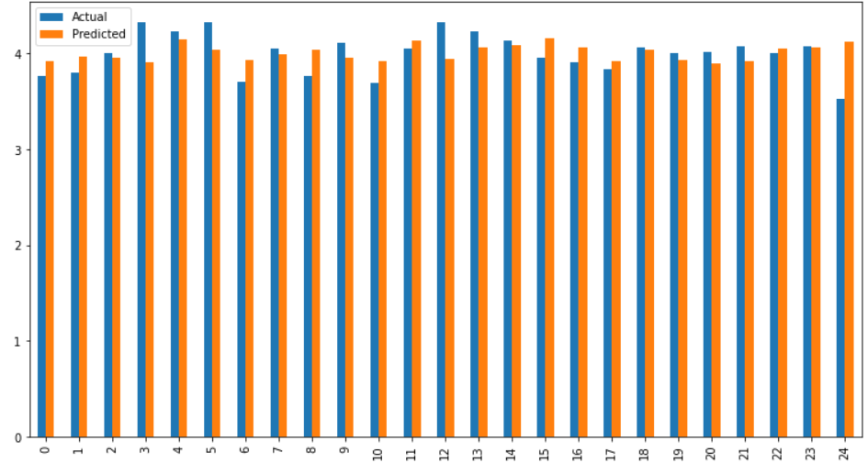
Machine Learning
After EDA part, we tried to create an algorithm to predict rating of book by his parameters. At first, we used Linear Regression method
MAE - Mean Absolute Error
MSE - Mean Squared Error
RMSE - Root Mean Square Error

Slide 26
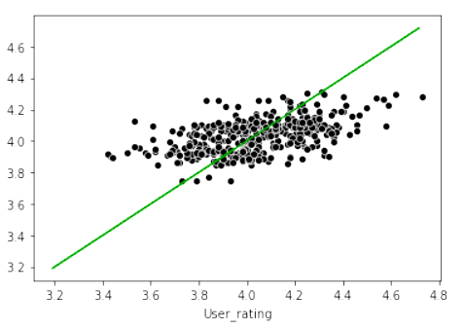
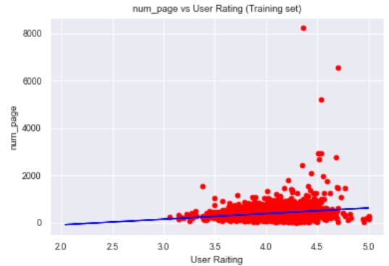
Machine Learning
User Rating VS Train/Predictions
We still felt that we can do one more thing…

Slide 27

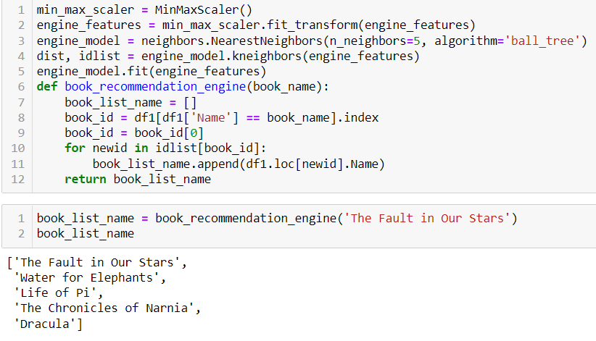
Wow efffect
Book Recommendation Engine

Slide 28
Summary

Slide 29
Conclusions
Conclusions
01
02
03
04
Users rating and their reviews is not something you can predict by book attributes only
Fantasy & Fiction are the most popular genres
Stephen King is the most popular fantasy books author
Probably there is no really correlation between books attributes

Slide 30
Summary
“And they have lived in happiness and wealth to this day…”
We founded that is no really correlation between attributes of books like their number of pages or released year, and we didn’t really managed to find a correlation between top rated books from the GoodReads site.
However, we can say that books in a non-metaphorical way are unpredictable, every book has it’s “story” and uniqueness. Nevertheless, maybe we could find a pattern if we were dig deeper in research. Dig to the districts of text analyses (of every book). Of course it is a way over our knowledge (yet ☺).

Slide 31
Summary
Credits
https://slidesgo.com/?utm_source=Slidesgo_template&utm_medium=referral-link&utm_campaign=SG_Credits&utm_content=slidesgo
https://www.kaggle.com/snanilim/book-recommendation-engine (code)

Slide 32
Summary
The End

